Slide 1
IoT System for pH Monitoring in Industrial Facilities
Pedro Silva nº47128 & Miguel Rocha nº47185 Supervised by: Professor Rui Duarte
Instituto Superior de Engenharia de Lisboa (ISEL)
Engenharia Informática e de computadores (LEIC)

Slide 2

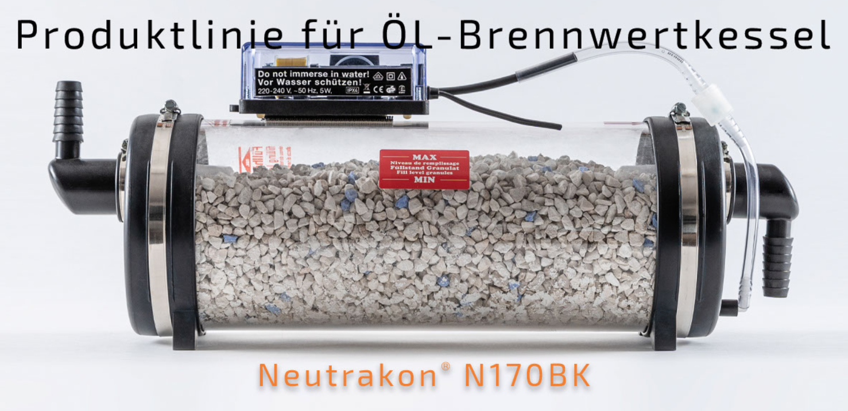
Motivation
3
Solution that leverages the power of the Internet of Things (IoT) to monitor pH levels of water in a neutralization device, allowing clients to be informed when the device is in need for maintenance.
3

Slide 3
Objectives
An electronic system designed to be energy-efficient, equipped with sensors for collecting data, and capable of transmitting the data to the cloud.
A backend responsible for:
Gather the received sensor data;
Process collected data, and alert the user, if necessary;
Expose a Web API, allowing other applications to interact with the system.
Intuitive and secure website, to register devices and consult sensor data.
4

Slide 4
Requirements By The Company
Cost-effective integration of the microcontroller unit into IoT sensor node;
• Prolonged battery life for minimal maintenance requirements;
• Comprehensive documentation for user-friendly operation and understanding;
• pH data reading from the filter;
• Notification to the filter owner or manager if any value exceeds a set threshold;
• Collect two pH readings per day.
4

Slide 5
Additional Requirements
Intuitive and user-friendly website design for easy navigation and access to information;
Proactive sensor calibration;
Adding more sensors to gather more data from the equipment;
Support for a role system, that includes an ”admin” that is meant to be a member of the company that will extract data from all the devices registered in the system and a ”client” representing a client of the company
4

Slide 6
Relevant Projects
SmartDoorLock-IoT;
CropX;
Devising an IoT-Based Water Quality Monitoring and pH Controlling System for Textile ETP;
Fish Feeding Automation and Aquaponics Monitoring System Base on IoT.
5

Slide 7
System Implementation
Architecture and decisions

Slide 8

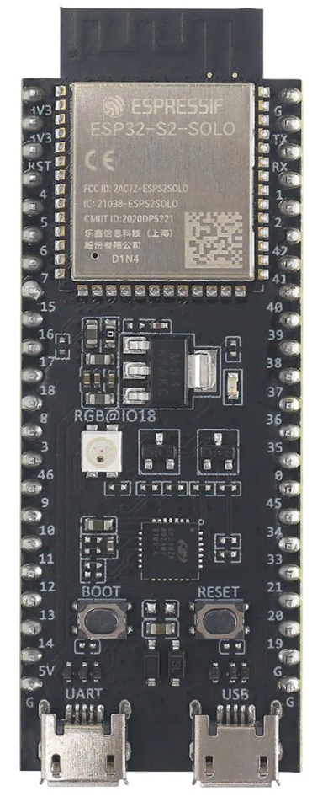
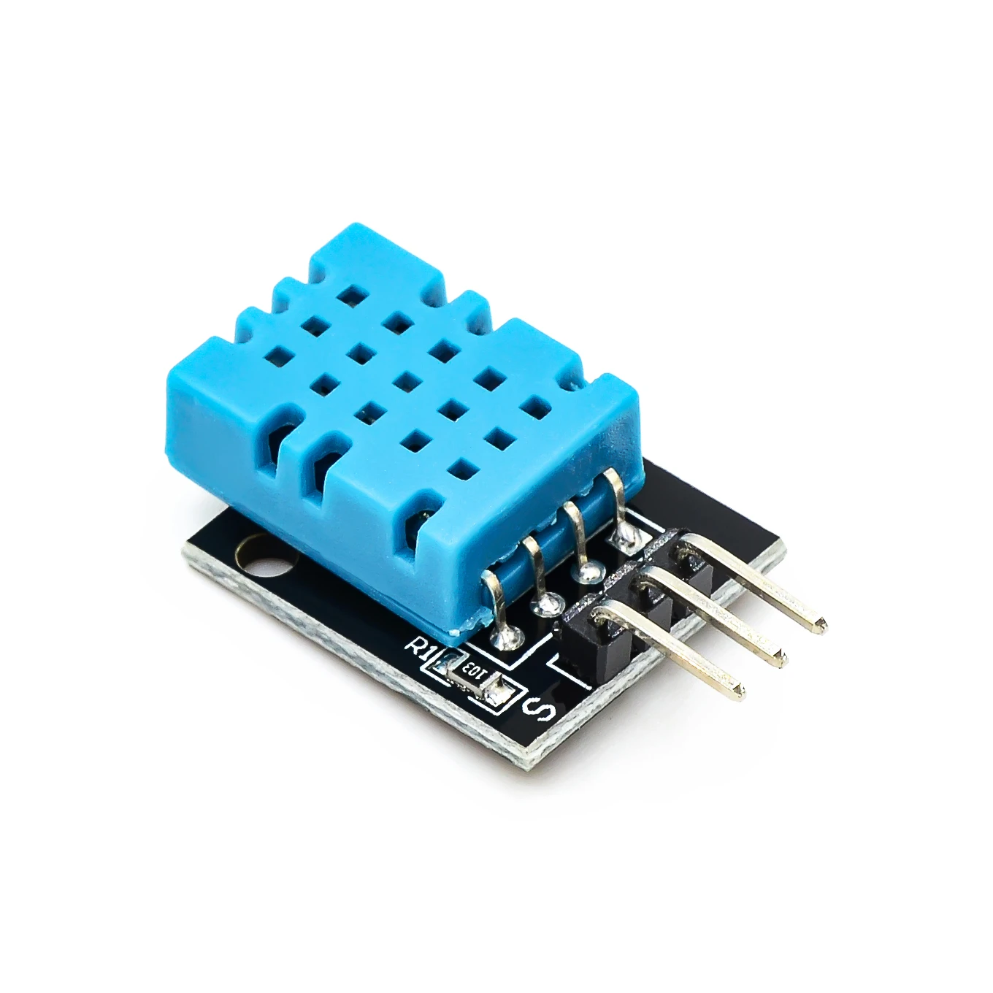
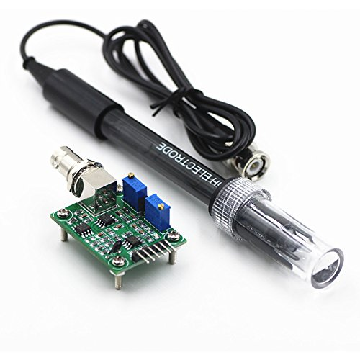
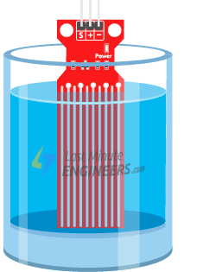
Background – IoT Node
Espressif framework
More control over the hardware;
Efficient Wide range of components, libraries, and drivers;
Resource Utilization;
Extensive Documentation
ESP32-S2
Sufficient CPU capabilities;
Built-in Wi-Fi module;
Low power consumption;
Cost-effective.
DHT11
Digital Sensor;
Multi-purpose
Water Sensor
Analog sensor;
Low-cost;
Easy placement.
PH Sensor
Analog Sensor;

Slide 9




Background – Backend
InfluxDB
Time-Series Data Storage;
Scalability;
Kotlin Support
Kotlin
Modern language;
Less verbose compared to Java.
Postgres SQL
Spring framework
Scalability;
Data Integrity and ACID Compliance;
Integration with Kotlin
Dependency Injection (DI);
Testing Support;
Embedded Security mechanisms.
11

Slide 10


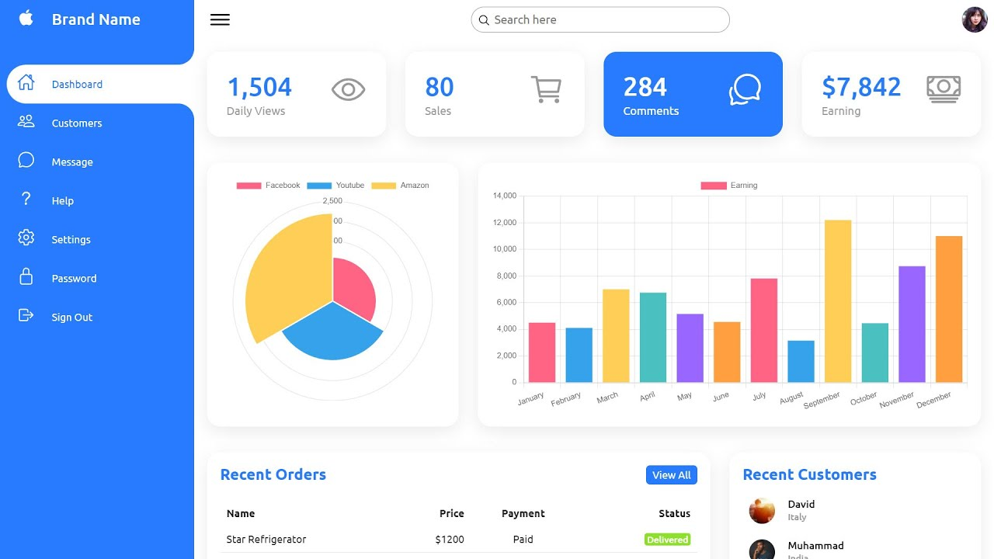


Background - Frontend
React
Chart JS
Component-Based Architecture;
Declarative Syntax.
Open source;
Easy to integrate
Webpack
Live Server;
Bundling with optimization
TypeScript
Type Checking
Chart JS examples

Slide 11
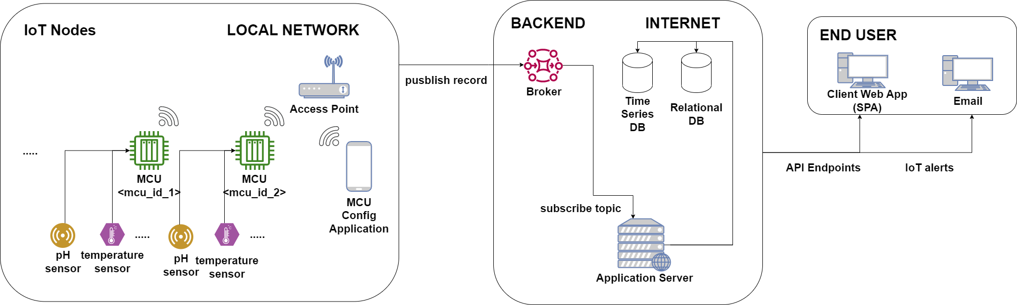
System Overview
3
Main system architecture
3

Slide 12
IoT Edge Node - Functionality
3
Wake up;
Checks wake up cause;
Sends wake-up log to backend, if necessary;
Makes sensor readings (all sensors or just water sensor);
Transmits readings to backend;
Goes to sleep for 6 hours;
MCU execution steps
3

Slide 13
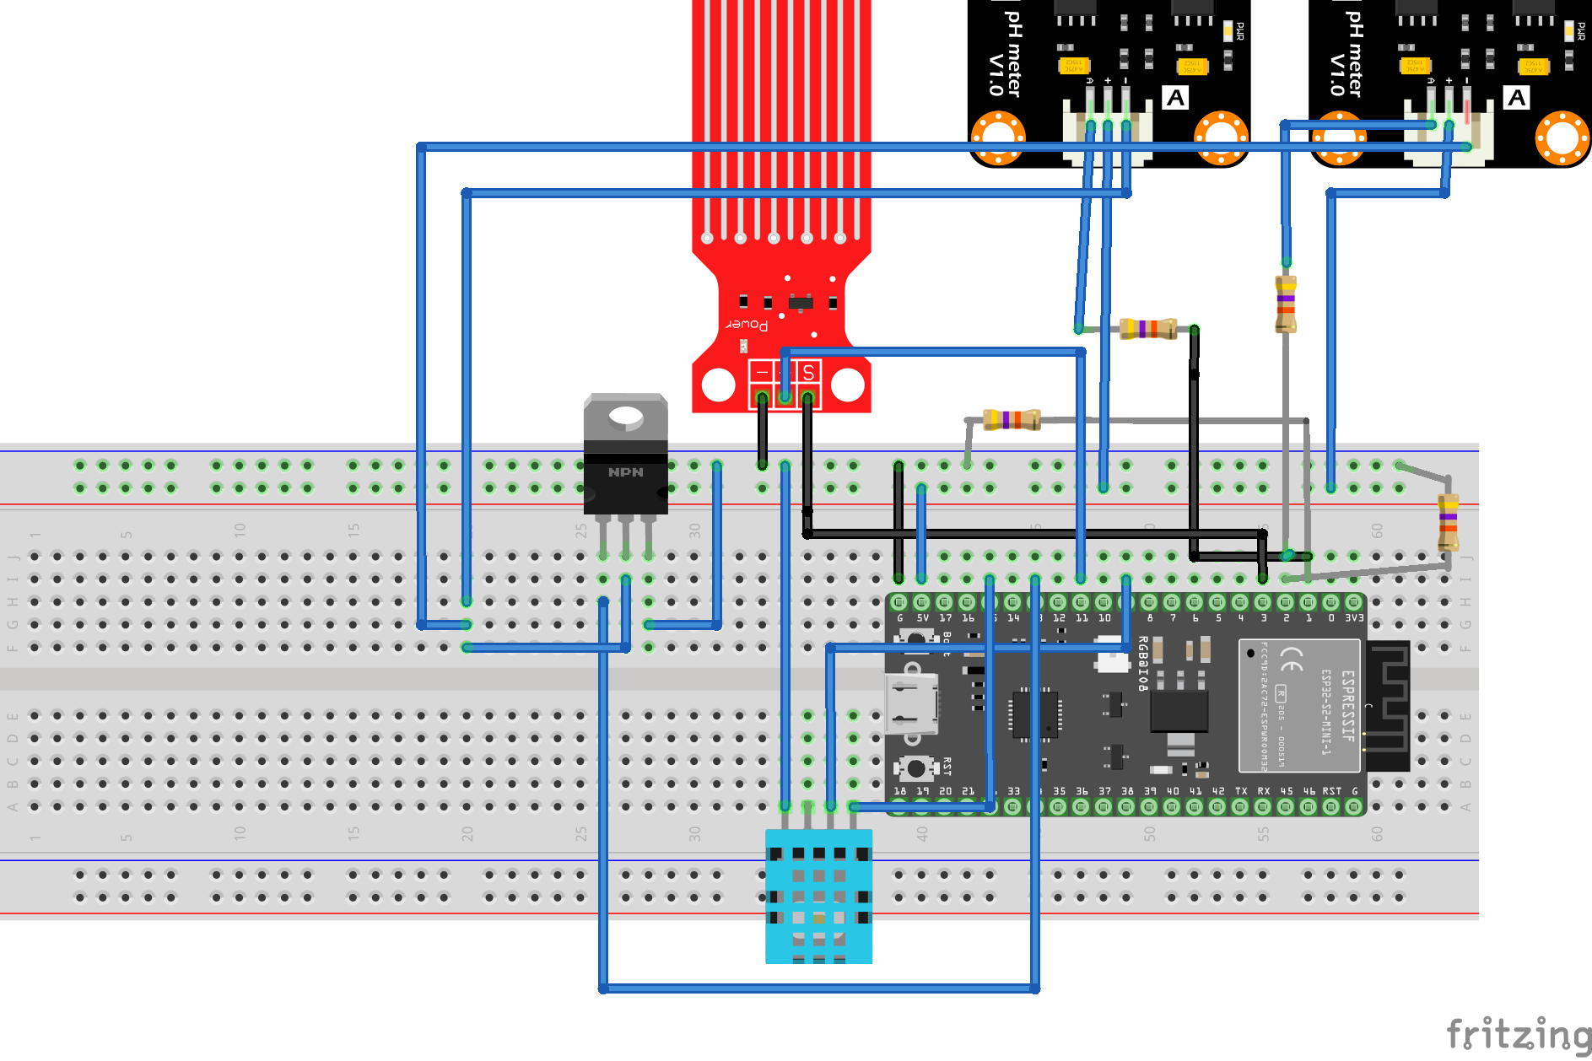
Assembly
3
3

Slide 14
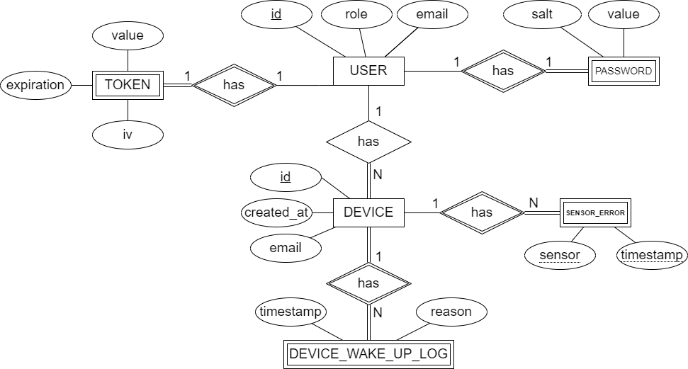
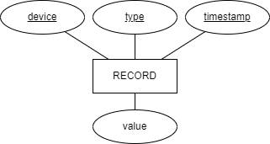
Database
3
Time Series DB Sensor Record representation
Relational DB Entity Mode
3

Slide 15
Backend API
3
Admin
List all users;
List user devices;
Visualize device sensor;
Visualize device logs user.
Non Authenticated
Create account;
Login.
Client
Create device
Access own devices
Visualize sensor data
Visualize device logs
3

Slide 16
Frontend - Website
3
3

Slide 17
System Evaluation
Experimental Results

Slide 18
Proactive Sensor Calibration
3
3

Slide 19
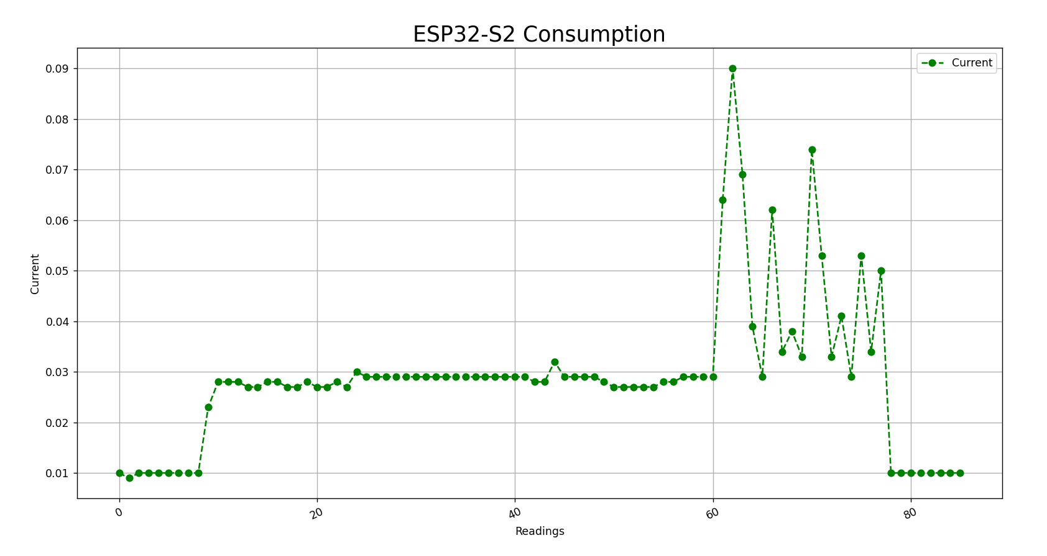
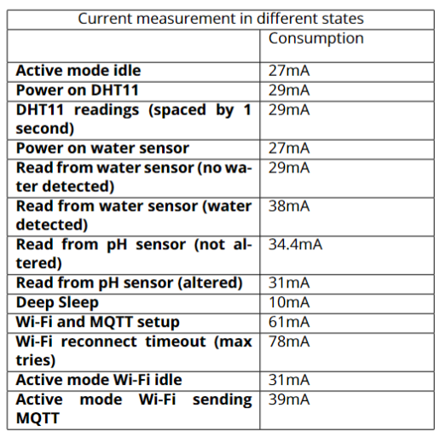
Power Consumption – Various Profiles
3
Graph illustrating the ESP32-S2 energy consumption measured when the MCU wakes up to read from all sensors
Results for the different MCU consumption stages
3

Slide 20
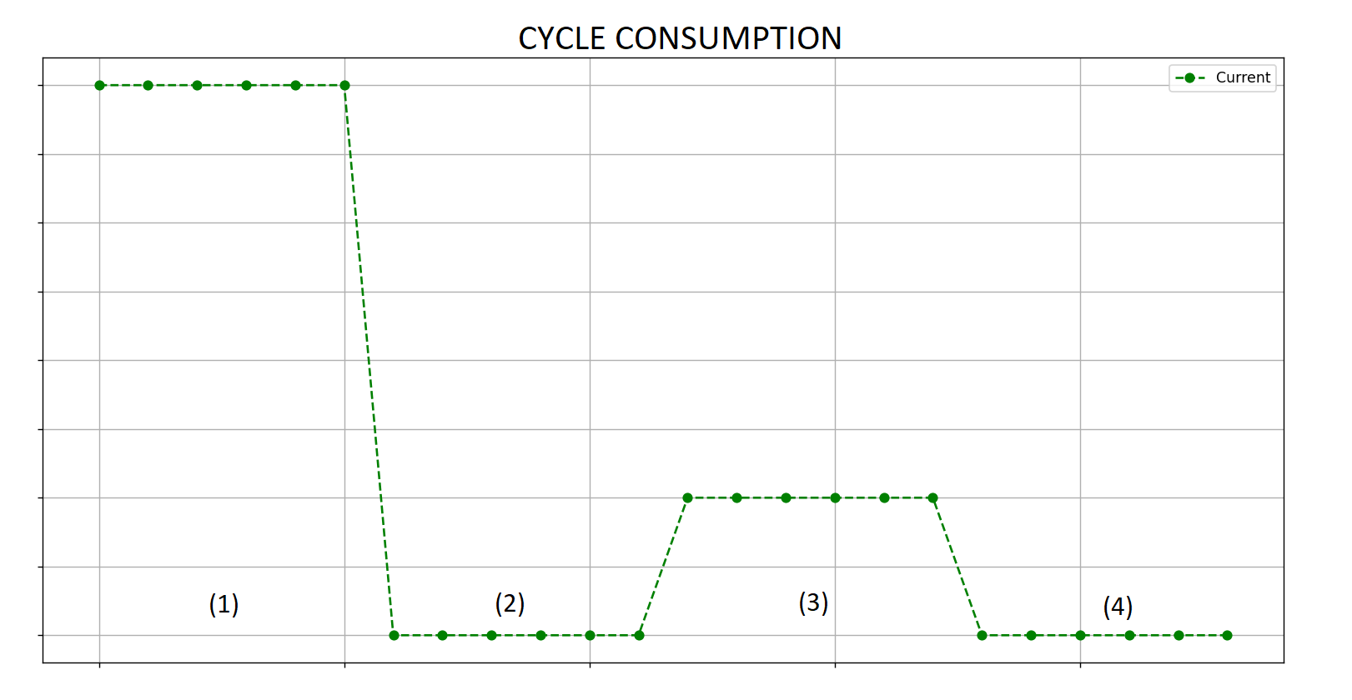
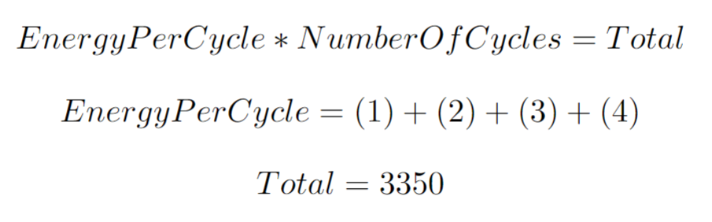
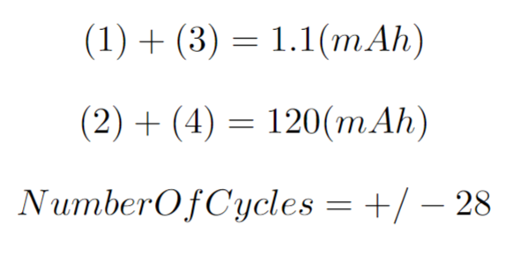
Power Consumption - Estimate
3
Image showing the 4 stages in a reading cycle
3

Slide 21
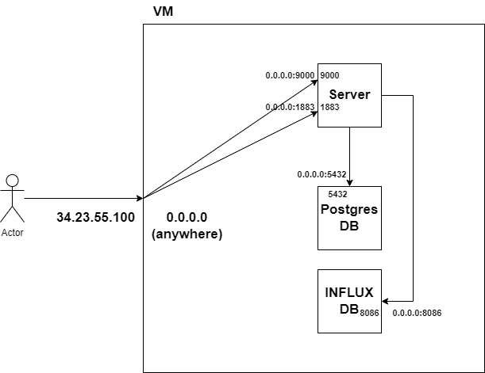
Deploy
3
Typical GCP VM, running the system docker containers

Slide 22
Future Work
3

Slide 23
END
Questions ?
29

Slide 24
Sensor Analysis
3
A configuration file is used to define each sensor upper and lower bound threshold
3

Slide 25
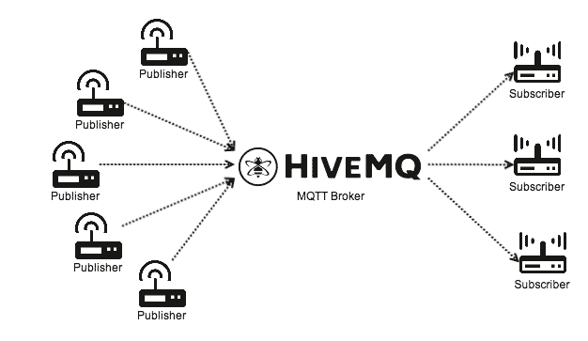
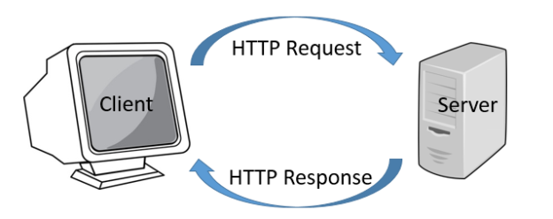
Background – Comunication Protocols
IoT Node comunication
API comunication
11

